Slide 1
- Coat off, bag under the desk, equipment on the desk.
- Write the title, date, and do the ‘Do Now’.
- Silence for the register and starter.
Notes:
Y7: https://www.mathsbox.org.uk/skills/ks3/10y7.php (ht1)
Y8: https://www.mathsbox.org.uk/skills/ks3/10y8.php (ht1)
Set 4: https://mathsbot.com/starters/numberOfTheDay
https://www.mathsbox.org.uk/sandc.php
Y9: https://www.mathsbox.org.uk/skills/ks4/10hb.php (ht2)
Y10: https://www.mathsbox.org.uk/skills/ks4/10ha.php (ht5)

Slide 3
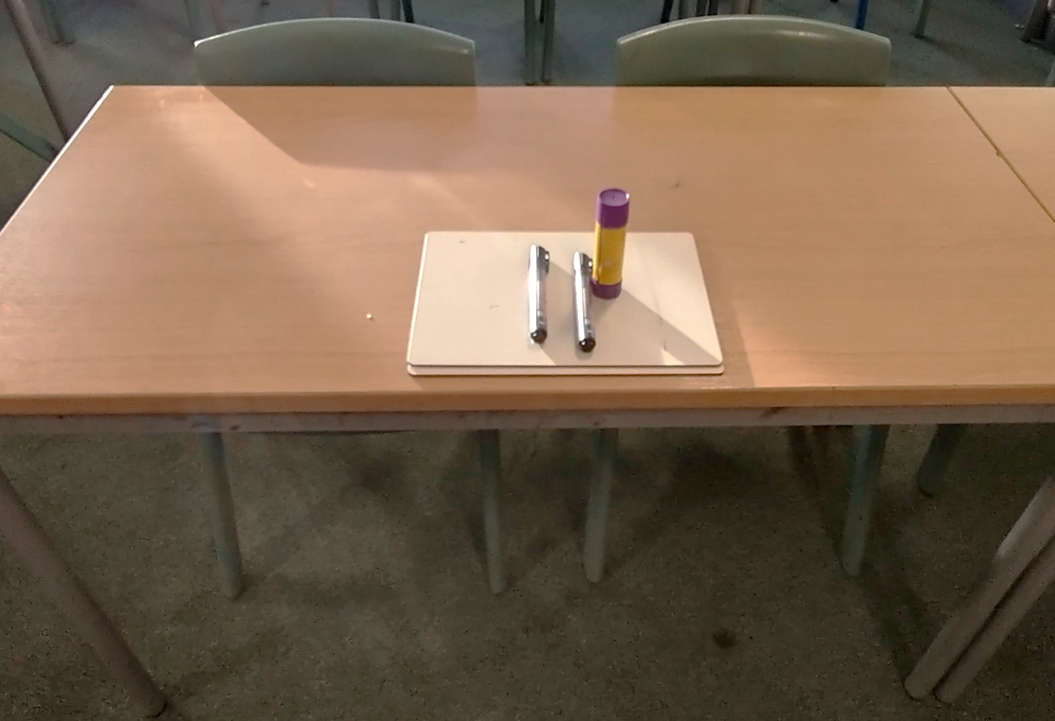





1. Stand in silence behind your desk.
2. Chairs tucked in, desk straight.
3. Classroom equipment neatly placed on the middle of the table.
4. Nothing left on the floor.

Slide 5
1) Record with a ☺, 😐, or ☹ how well you did on each question.
2) Choose one topic you can improve on and set that as your target.
3) Record your score on the topic sheet at the front of your book.
4) Have a go at one of the TRIO questions on the board.

Slide 6
Homework
- Write the question and show your working.
- Bring your completed homework to the lesson (either in your book or on paper).
- I will not accept homeworks without workings, or submissions on Firefly.
- If you do not bring your homework in, you must bring it to the Maths Office dropbox by the next Wednesday.
Any questions, email me at: cquickfall@gordanoschool.org.uk

Slide 7
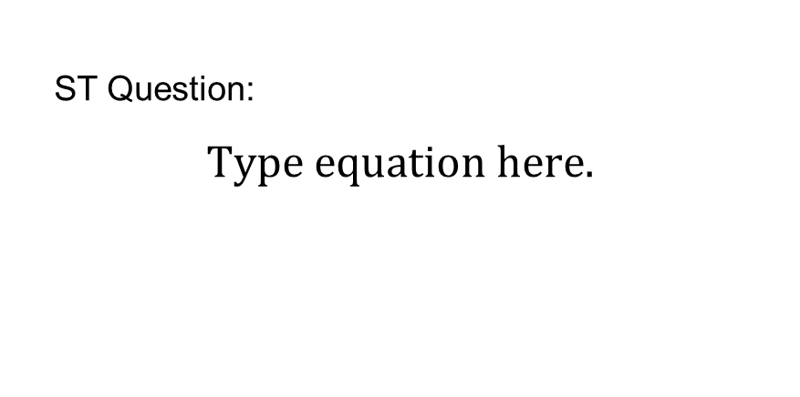
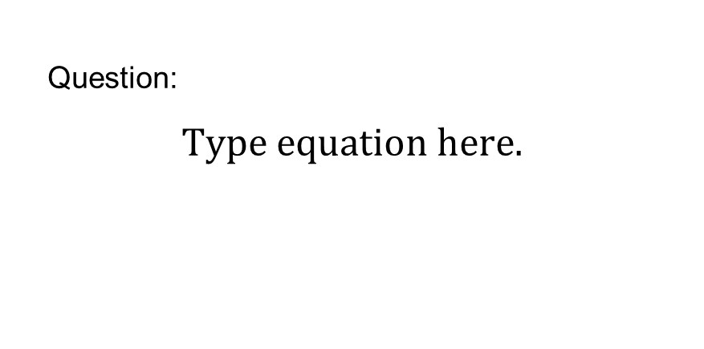
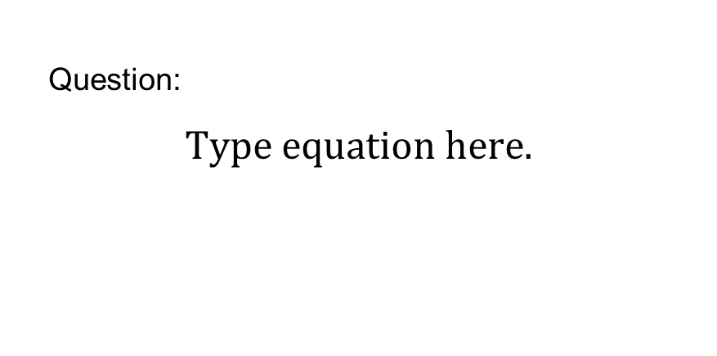
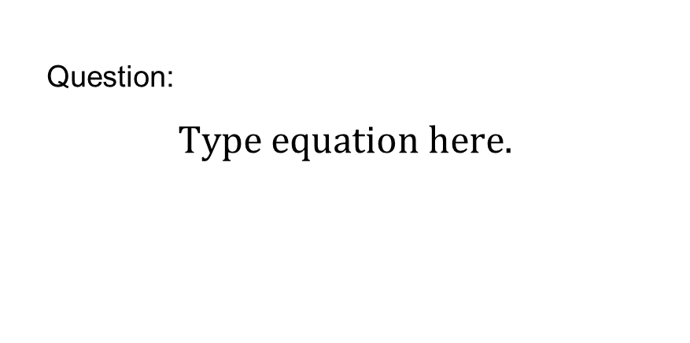
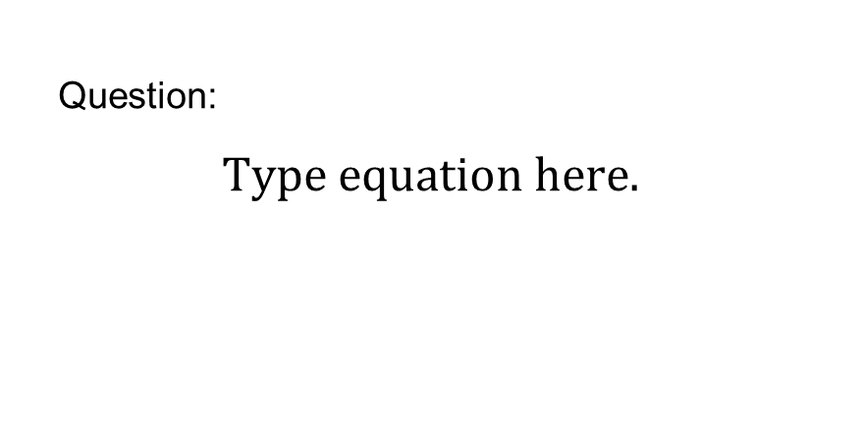
Copy the examples into your book.
ST Question:
Question:
Question:
Question:
Question:

Slide 8
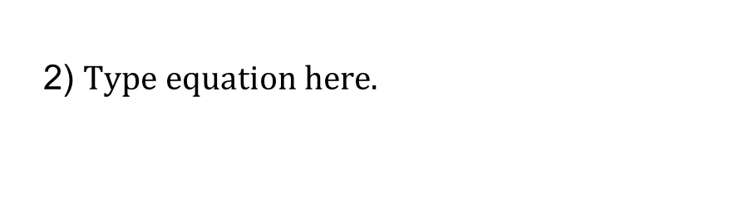
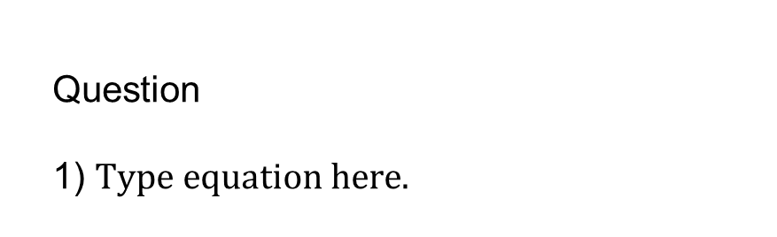
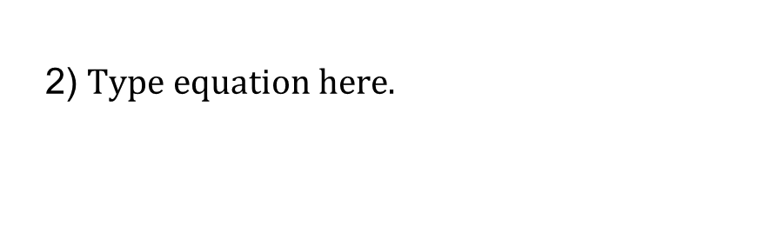
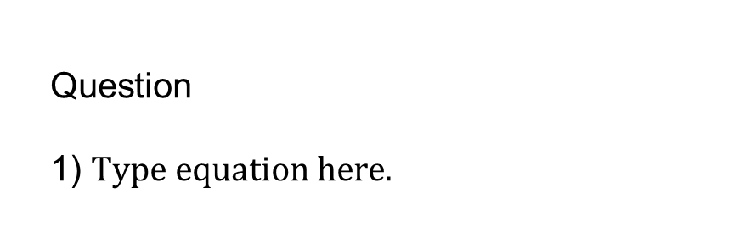
Copy everything on the left of this slide into your book.
Question
1)
Question
1)
2)
2)

Slide 9
Today:
Starter (done!)
5-minute break
Breaktime ☺

Slide 10
Mini-assessment:
- Test conditions (silence, no communication)
- No books
- No calculators

Slide 11
5-minute break

Slide 12
Stick me in when your teacher tells you to by putting glue in this special box.

Slide 13
1)
7)
! To write down
Instructions
2)
8)
3)
9)
4)
10)
5)
11)
6)
12)
Information/Questions
Answers

